Slide 1
REPORTLAB COMPLETE TUTORIAL
How to generate pdf report from json using reportlab:Part 56
TOTAL TECHNOLOGY

Slide 2
response":[{"country":"China","cases":{"new":"+32","active":1242,"critical":211,"recovered":77167,"total":81740},"deaths":{"new":null,"total":3331},
"tests":{"total":null},"day":"2020-04-07","time":"2020-04-07T19:15:05+00:00"},
{"country":"Italy","cases":{"new":"+3039","active":94067,"critical":3792,"recovered":24392,"total":135586},"deaths":{"new":"+604","total":17127
https://rapidapi.com/api-sports/api/covid-193
Api link
How to generate pdf report from json
TOTAL TECHNOLOGY

Slide 3


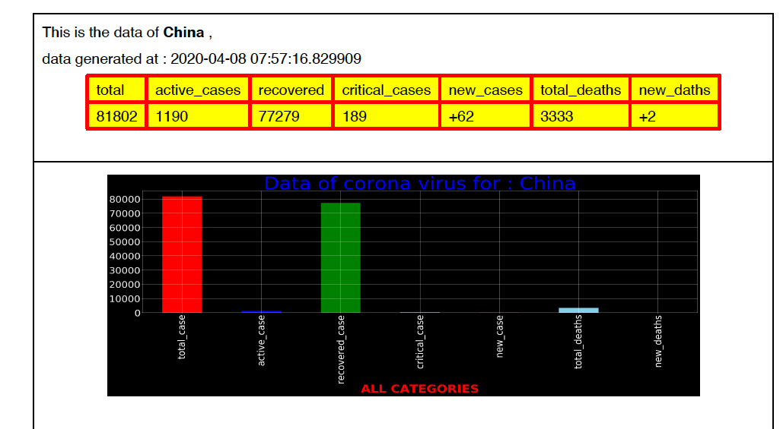

z
output

